Slide 1
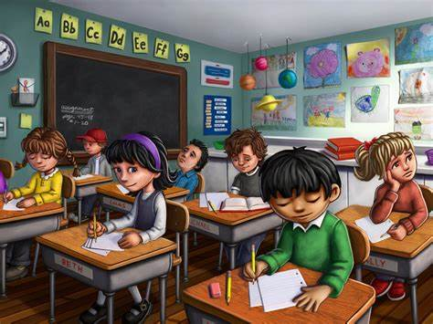
Escape room
Slovenia

Slide 2
Click to begin

Slide 3
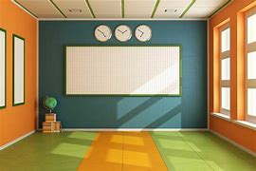
HA-HA! I’ve caught you now!
You are trapped in fruit storage. To get out you need to solve my puzzles and escape!
Click on different items to get your tasks!
Instructions:
Do NOT use the space bar / arrows / keyboard at any time!
Click to begin

Slide 4
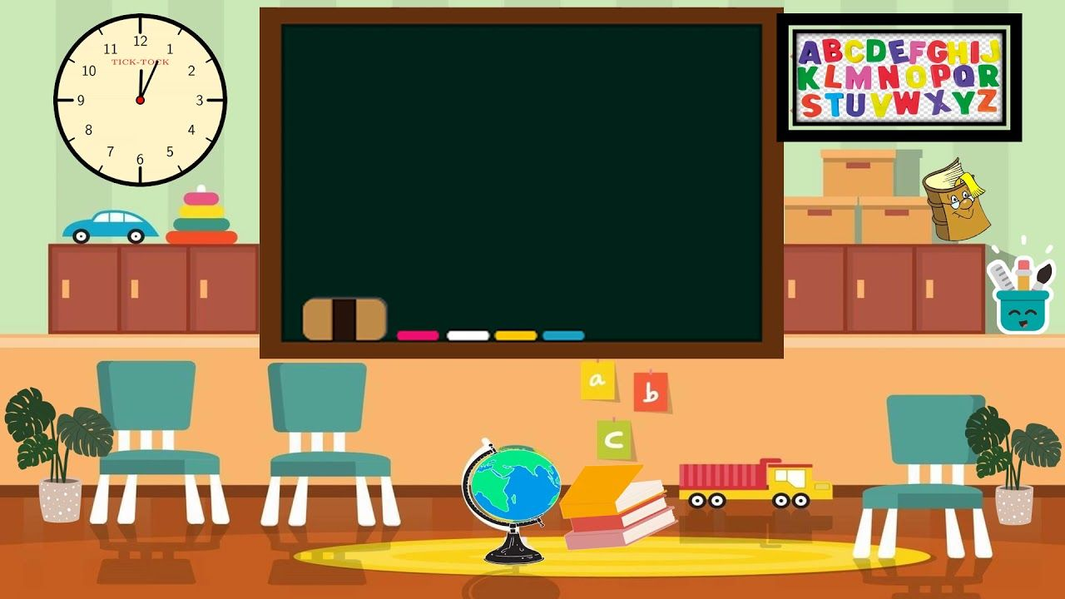

Slide 5
There are 24 classrooms in the school. Four classrooms are Maths classrooms. What part of all classrooms are Maths classrooms?
1⁄6
1⁄8
1⁄4

Slide 6
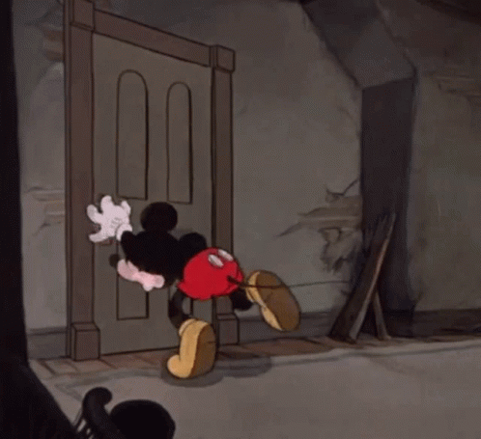
You are still trapped
Try again

Slide 7
One step closer to freedom!
Correct!
Solve another puzzle

Slide 8
There are 20 pupils in 5.a class, 12 of them are girls. What part of all pupils are boys?
2⁄5
1⁄5
3⁄5

Slide 9
You are still trapped
Try again

Slide 10
One step closer to freedom!
Correct!
Solve another puzzle

Slide 11
There are 32 pencils in your pencil case. 1⁄4 of them are colour pencils. How many colour pencils do you have?
12
10
8

Slide 12
You are still trapped
Try again

Slide 13
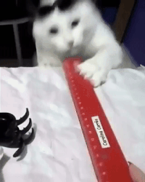
One step closer to freedom!
Correct!
Solve another puzzle

Slide 14
Have you solved all three tasks yet?
YES
NO

Slide 15
Which three school supplies were shown in the GIFs by the correct puzzle answers?
Ruler, book and pencil
Book, eraser and pencil
Ruler, eraser and book
Pencil, book and pencil case

Slide 16
Good job!
You are free!

Slide 17
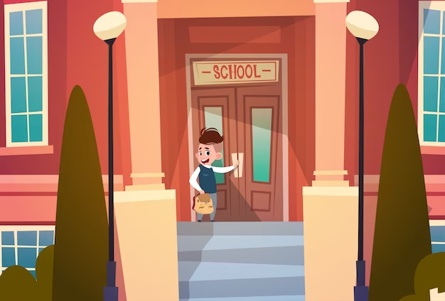
Project: Maths is Fine with Digital Style
Project number: 2021-1-CZ01-KA220-SCH-000027773
The European Commission's support for the production of this publication does not constitute an endorsement of the contents, which reflect the views only of the authors, and the Commission cannot be held responsible for any use which may be made of the information contained therein.

